Slide 1
Command Based Programming
2020 Command Based Approach

Slide 2
Commands and Subsystems
Utilizes
Commands
Subsystems
High-level robot actions that may utilize methods defined by the Subsystems
Examples:
DriveForward
ShootBall
IntakeBall
Basic unit of robot organization.
Examples:
DriveTrain
Intake
Elevator
Shooter
driveForwardCommand aButton.whenPressed(intakeSubsystem::run);

Slide 3
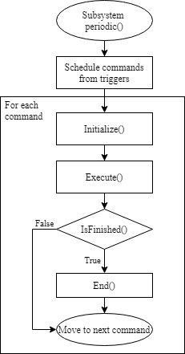
Command Scheduler
Scheduler
Robot.java - robotPeriodic()
CommandScheduler.getInstance().run();
// Runs every 20 ms (50 cycles / sec)
Command 1
Command 2
Called Only Once
Command 3
Command 4
…

Slide 4
Initial Setup
Robot.java
RobotContainer.java
@Override
public void robotInit() {
m_robotContainer = new RobotContainer();
}
@Override
public void robotPeriodic() {
CommandScheduler.getInstance().run();
}
public class RobotContainer {
// The robot's subsystems and commands are defined here...
private final GondolaSubsystem gondolaSubsystem = new GondolaSubsystem(RobotMap.GondolaMotor);
private GondolaCommand gondolaCommand;
public RobotContainer() {
setupDefaultCommands();
configureButtonBindings();
}
private void setupDefaultCommands(){
gondolaSubsystem.setDefaultCommand(
new GondolaCommand(gondolaSubsystem,
() -> deaden(Buttons.secondaryJoystick.getX(Hand.kLeft)))
);
}
A command that will automatically be scheduled when no other command is currently using the subsystem

Slide 5
Triggers
whenActive/whenPressed – when button changes from inactive to active
whileHeld – command will be rescheduled once completed
whenHeld – command will not be rescheduled once completed
whenReleased – when button changes from active to inactive
toggleWhenPressed – performs a toggle option
cancelWhenPressed – cancels an already running command
private void configureButtonBindings() {
// primary controls
Buttons.primaryAButton.whenPressed(new ShiftLowGearCommand(driveTrainSubsystem));
Buttons.primaryYButton.whenPressed(new ShiftHighGearCommand(driveTrainSubsystem));
Buttons.secondaryBButton.whenHeld(new ReverseIndexToBlasterCommand(intakeSubsystem));
}

Slide 6
Subsystem Class
public class GondolaSubsystem extends SubsystemBase {
/**
* Creates a new GondolaSubsystem.
*/
public WPI_VictorSPX gondolaMotor;
public GondolaSubsystem(WPI_VictorSPX gondolaMotor) {
super();
this.gondolaMotor = gondolaMotor;
}
public void operateGondola(double speed) {
gondolaMotor.set(ControlMode.PercentOutput, speed);
}
@Override
public void periodic() {
// This method will be called once per scheduler run
}
}
Constructor – called once when the Subsystem is created in RobotContainer
super() is important – this registers this subsystem with the Scheduler
Called once per Scheduler run

Slide 7
Command Class
public class GondolaCommand extends CommandBase {
public DoubleSupplier gondolaSpeed;
private final GondolaSubsystem gondolaSubsystem;
public GondolaCommand(GondolaSubsystem gondolaSubsystem, DoubleSupplier speed) {
this.gondolaSubsystem = gondolaSubsystem;
gondolaSpeed = speed;
addRequirements(gondolaSubsystem);
}
@Override
public void initialize() {
}
@Override
public void execute() {
gondolaSubsystem.gondola(gondolaSpeed.getAsDouble());
}
@Override
public void end(boolean interrupted) {
}
@Override
public boolean isFinished() {
return false;
}
}
Constructor – called once when the Command is created
Called every time a command is scheduled to run
Called every time scheduler runs this command
Called every time scheduler stops this command

Slide 8
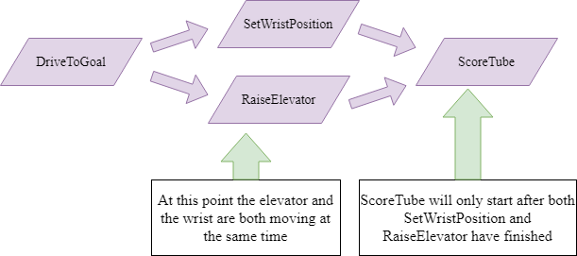
Command Groups
Grouping of Commands
Command Groups themselves are Command Objects and hence,
  Command Groups can be passed where Command objects are accepted
  A command group can contain other command groups

Slide 9
SequentialCommandGroup
Command 1
Command 2
Command 3
Command 1
ParallelCommandGroup
Command 2
Done when all the commands are done
Command 3
Command 1
ParalleRaceGroup
Command 2
Done when any command in the group is done.
Command 3
Command 1
ParalleDeadlineGroup
Done when selected command in the group is done.
Command 2
Command 3

Slide 10
Limitations and Dependencies
Multiple commands can run concurrently, as long as they do not require the same resources on the robot – that is, it is not dependent on the same subsystem

